Slide 1


AstroSage Call
Center Analysis
Presented by – Devesh sahu

Slide 2

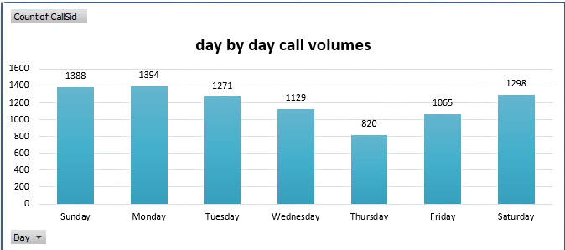
Introduction and Objectives
Introduction :
Did you know that call centers handle over 200 billion customer interactions every year worldwide?
For AstroSage, the call center plays a critical role in customer experience, satisfaction, and revenue generation.
Project Context:
This project analyzes AstroSage’s call center data to uncover patterns in call volumes, agent performance, and customer satisfaction.
Insights from this analysis will guide strategic investments in hiring, training, and technology upgrades.
Objectives:
Analyze daily, monthly, and hourly call volumes to understand demand trends.
Evaluate agent performance and workload distribution to ensure efficiency.
Assess customer satisfaction levels
Compare AstroSage’s performance with competitor benchmarks (AstroGuru).
Provide data-driven recommendations for investment in hiring, training, and
technology.

Slide 3
Problem Statement
The AstroSage call center handles a large volume of customer interactions across multiple consultation types, platforms, and agents. However, variations in call volume, agent workload, customer satisfaction, and revenue performance make it challenging to identify inefficiencies and growth opportunities.
Without a centralized, data-driven view of operations, it becomes difficult to:
Understand demand patterns and peak call periods
Balance agent workload effectively
Identify factors influencing customer satisfaction and repeat calls
Evaluate revenue performance across consultation types and platforms
This project aims to address these challenges by analyzing historical call center data to uncover actionable insights that support better operational decisions, improved customer experience, and strategic investment planning.

Slide 4

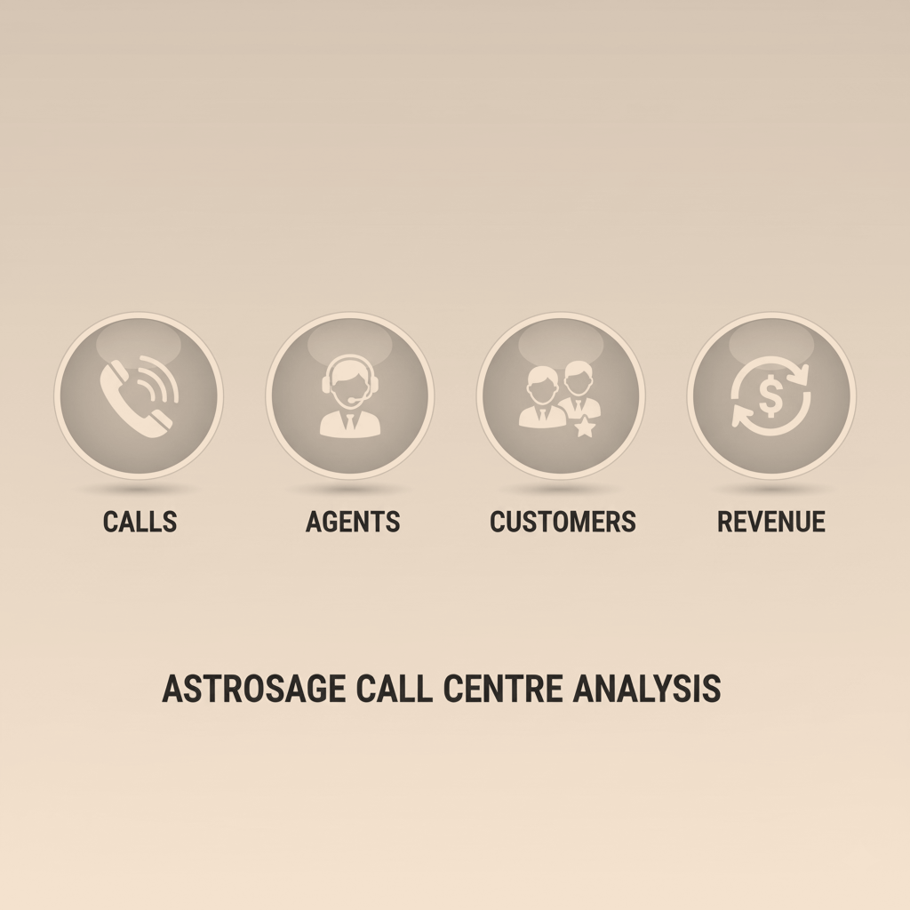
Data Overview
Dataset :
Data sourced from AstroSage Call Center operations.
Includes 40+ attributes covering call details, agents, users, and financials.
Data Cleaning & Preprocessing:
Handled inconsistent categorical values (e.g., call status variations).
Converted date & time columns into day, month, and hourly slots.
Filled/treated missing values and removed irrelevant technical fields.
Why This Data Matters:
Provides a 360° view of customer interactions.
Enables analysis of call volume patterns, agent efficiency, customer satisfaction, and revenue generation.
Forms the foundation for data-driven decisions on hiring, training, and technology upgrades.

Slide 5
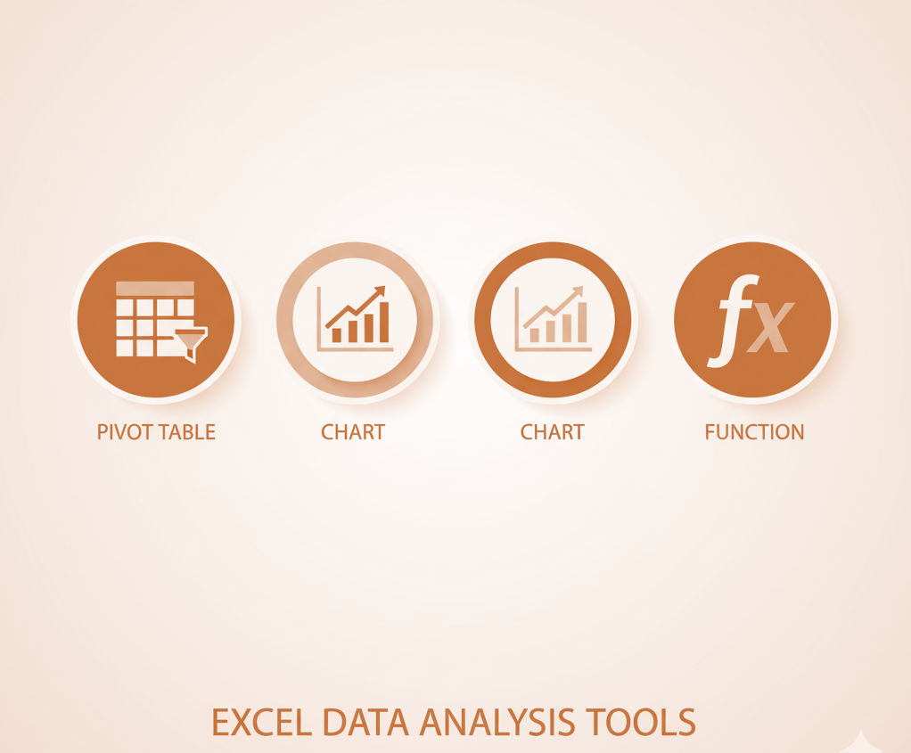
Methodology
Steps Followed in Analysis:
Data Cleaning:
  Removed inconsistent strings in categorical
  Handled missing values
  Data Enrichment:
  Extracted day, month, and hourly slots from CreatedAT.
Analysis Performed:
  Trend Analysis: Daily, monthly, and hourly call volumes.
  Agent Performance: Calls handled per agent per day.
  Customer Satisfaction: Ratings vs call duration correlation.
  Financial Analysis: Sales and earnings per guru and product category.
Tools & Functions Used:
PivotTables & PivotCharts – for aggregation and visualization.
COUNT, AVERAGE, CORREL – for calculating call volumes, satisfaction, and correlations.
IF, TEXT, CHOOSE, VLOOKUP – for categorizing, extracting, and enriching data.
Slicers – to enable interactive filtering across the dashboard.

Slide 6
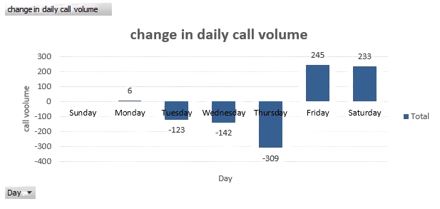

Analysis of Objective Questions
Daily & Monthly Call Volume Trends
Visuals:
Column Chart – Daily call volume
Column Chart – Month-wise total calls.
Key Takeaways:
Daily call volumes showed fluctuations, with peak loads during weekends/holidays.
Highest call volumes were observed in December, lowest in January.
The average daily call volume was ≈ 246 Calls, useful for resource planning.

Slide 7
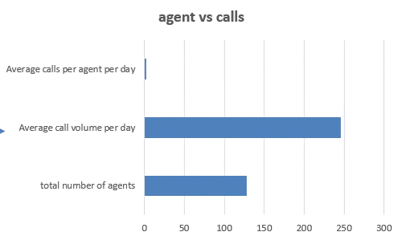
Agent & Customer Performance
Agent & Customer Performance
Visuals:
Bar Chart – Average calls handled per agent per day.
Pie/Donut Chart – Distribution of calls by repeat vs new customers.
Key Takeaways:
On average, each agent handled 1.9 calls /day.
Repeat callers
represented 42% of total calls, showing strong loyalty but also highlighting potential unresolved issues.
Certain agents consistently scored higher satisfaction ratings, indicating the impact of training & experience.

Slide 8
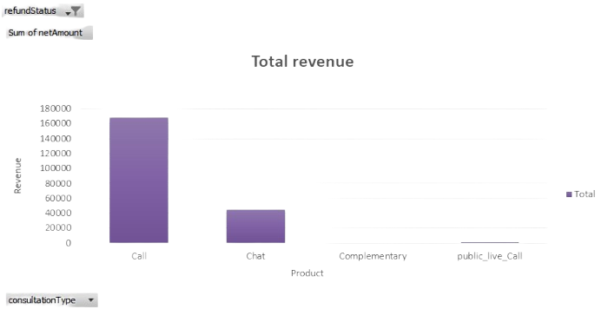
Financial & Satisfaction Analysis
Visuals:
Stacked Column Chart – Total sales by product category.
Key Takeaways:
Highest revenue was generated from calls, while Other category contributed the least.
Moderate positive correlation observed between call duration and satisfaction → longer calls often resulted in Lower ratings.
Gurus with the highest ratings also had stronger financial performance, showing a direct link between service quality and profitability.

Slide 9
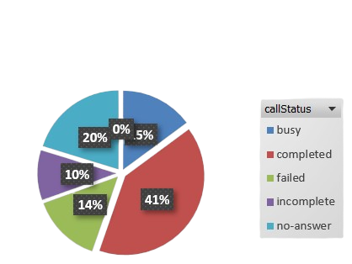
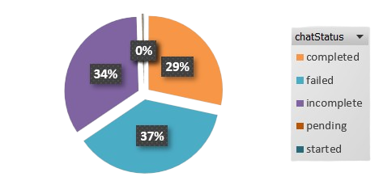
Insights from Subjective Questions
Investment Decisions
Content:
Insight: Whether to prioritize hiring, training, or technology
upgrades.
Rationale:
  Hiring → Reduces call wait time but increases costs.
  Training → Improves efficiency & quality of customer handling.
  Technology upgrades → Long-term productivity and better tracking.
Visualization Suggestion: pie chart to show the Call and Chat status.
Story Angle: “Balancing short-term workload relief with long-term efficiency improvements.”

Slide 10
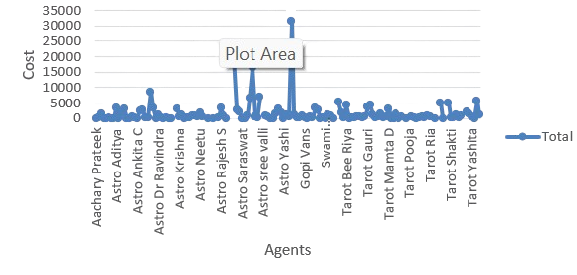
Risks & Mitigation
Content:
Insight: Risks in each strategy (hiring, training, technology).
Rationale:
  Hiring → Attrition risk, high recurring costs.
  Training → Inconsistent outcomes if not standardized.
  Tech upgrades → Initial high cost, adoption challenges.
Visualization Suggestion: Line chart .
Story Angle: “Every decision comes with risk, but proper
mitigation ensures stability.”

Slide 11
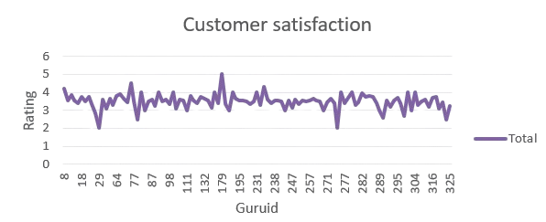
Strategic Initiatives for Growth
Content:
Insight: Focus on efficiency + customer satisfaction.
Rationale:
  Improve handling during peak hours (load balancing).
  Track satisfaction trends → identify pain points.
  Leverage automation & analytics for faster response.
Visualization Suggestion:
  Line chart
Story Angle: “Strategic focus on data-driven efficiency ensures long-term sustainability.”

Slide 12

Conclusion
Key Findings:
Daily and monthly call volume trends reveal peak hours and workload imbalances.
Customer satisfaction strongly correlates with call duration, agent efficiency, and service quality.
Repeat callers and sales distribution highlight both loyal customers and potential revenue growth areas.
Agent performance varies significantly, requiring better workload balancing and training.
Implications:
Optimizing staffing and technology can reduce wait times and improve customer experience.
Data-driven decision-making will help in prioritizing investments to maximize efficiency and profitability.
Closing Statement:
“By leveraging insights from data, the call center can transform operational efficiency, enhance customer satisfaction, and ensure sustainable growth in a competitive market.”

Slide 13
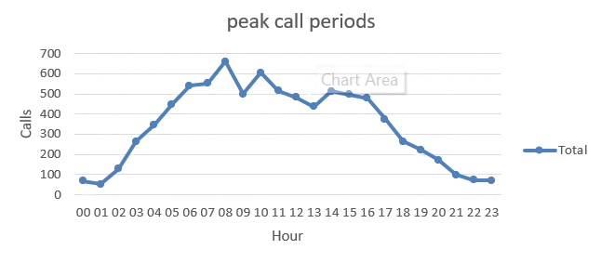
Strategic Recommendations
Recommendation 1 – Optimize Workforce
Content:
Recommendation: Hire selectively while enhancing training.
Reason (Data-driven): Peak hour analysis shows high call waiting time; trained agents handle calls faster with higher satisfaction scores.
Expected Impact:
  Reduced wait times.
  Improved first-call resolution.
  Higher customer satisfaction and retention.

Slide 14
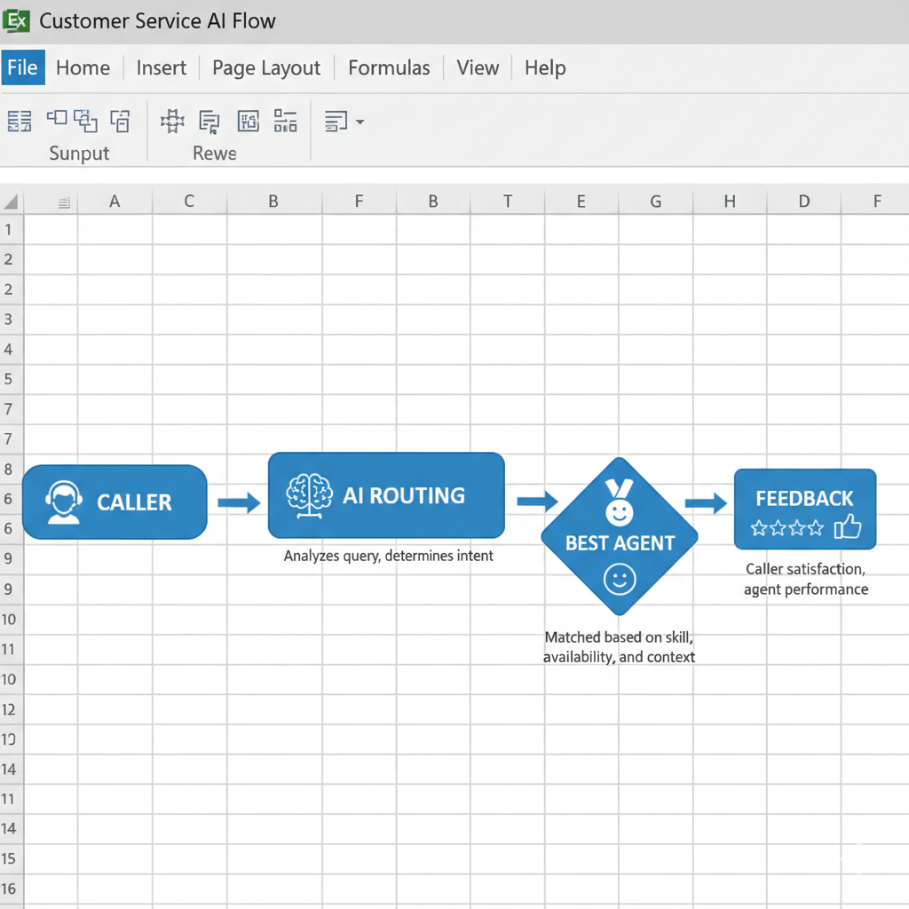
Recommendation 2 – Leverage Technology
Content:
Recommendation: Invest in AI-driven call routing & analytics dashboards.
Reason (Data-driven): Call duration vs. satisfaction analysis shows mismatches; automation helps balance load across agents.
Expected Impact:
  Smarter workload distribution.
  Better monitoring of agent performance.
  Long-term cost savings.
  Visual Suggestion: Process flow infographic (Caller → AI Routing → Best Agent → Feedback).

Slide 15
Recommendation 3 – Strategic Initiatives for Growth
Content:
Recommendation: Focus on customer-centric KPIs in dashboard (Satisfaction, Call Resolution, Repeat Call %, Sales by category).
Reason (Data-driven): Identified gaps in repeat callers & product-wise sales performance.
Expected Impact:
  Better decision-making for expansion.
  Stronger market positioning.
  Boost in profitability by targeting weak areas.

Slide 16
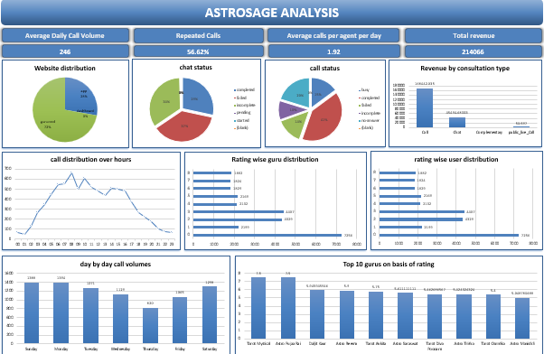
Dashboard and Visualizations

Slide 17


